Slide 1

Fire Simulation and Modelling for Data Centers
Submission 4 – Group Presentation Paper Draft 1
Group 2
Course | Petri Net Theory And Modeling Of Systems (CSE718)
Faculty | Annajiat Alim Rasel [AAR]
Name | ID
Sushana Islam Mim | 22273001
Mirza Ahmad Shayer | 22273008
Salman Sadat Nur | 22273011
Nazia Parvin | 23166034

Slide 2
Abstract – Data is the modern day important currency that the world runs on. It is crucial that this data is safely stored and not lost. Servers come to mind when large data storage is required. Many servers are needed, so server racks are grouped together in buildings - called data centers. Anytime any disaster can strike. Fires often break out of data centers which are difficult to control. All data in the racks are destroyed. fire modelling in data centers are essential to stop fires from destroying servers. A background study is conducted in chapter 2. Details on data center fire detection is discussed in 3, followed by fire suppression systems in 4. Chapter 5 shows a graph-based approach to fire detection-suppression with all details and model simulation is shown in 6. Lastly, conclusion then future research.

Slide 3
Introduction
In the rapidly evolving landscape of our digital era, data has emerged as the cornerstone of our technological progress, functioning as the most valuable currency. The intricate web of our global society relies heavily on various forms of data, making its secure storage and preservation a paramount concern. Data centers are the nerve center of any organization or country.
The requirement for enormous data storage and processing capacity is driving the skyrocketing demand for data centers as technologies like artificial intelligence (AI), the internet of things (IoT), and cloud computing become more popular with consumers and companies. Heavy investments in new digital infrastructure to support this expansion are required. Securing the infrastructure with data center fire protection is absolute

Slide 4
Introduction (Continued)
While these centers are designed to be secure, the specter of unforeseen disasters, particularly fires, looms ominously. Protecting the vital data and computer resources kept in data centers requires effective fire protection. Servers may sustain irreversible damage from fire, which could result in disastrous data losses involving banking transactions, medical records, intellectual property, etc.
A well-structured security plan against rampant fires must be created, taking into account the context in which it will be executed, in order to prevent incidents of this kind.
In light of this, mapping and understanding the statistical information on fires- like their types, number of incidences per year, and confirmed fatalities- is crucial. In the pursuit of fortifying data centers against the looming threat of fires, this endeavor aims to refine and expand upon a graph-based approach.

Slide 5
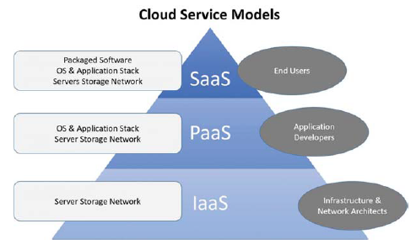
Background
In the data center, there are often racks of servers. The servers contain all data - which is considered the cloud. According to Ahmed, Khadhim and Kadhim, ownership of cloud infrastructures are shared over the internet. Additionally, services provided by the cloud is superior, reliable and easy to utilize. Three models of cloud computing are very common - Infrastructure as a Service (IaaS), Platform as a Service (PaaS) and Software as a Service (SaaS).

Slide 6
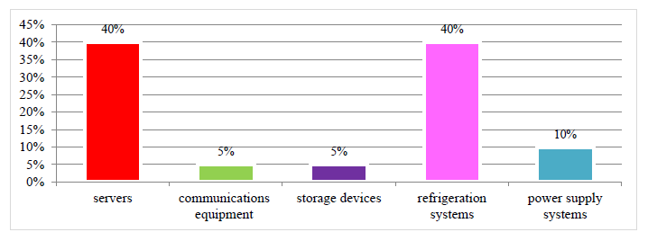
Background (Continued)
According to Nasri, rack servers are major energy misspending factors. Servers that consume less energy are important for continuous evolution of the data centers. There is a linear relation between CPU utilization and power consumption in the server. Servers are the most energy consuming factor. Controlling the temperature is very important. Almost as much as 40% of electricity is consumed via data centers and its devices.

Slide 7
Background – Sources
Fire is a combination of four elements - heat, fuel, oxygen and a chain reaction process - combustion. Fires in data center are different when compared to typical house fires. Most often these are electrical fires. According to Zhang, in data center a variety of materials can be considered as combustibles. They are given as –
Electronics - routers, power switches, servers, power supplies, batteries and wire insulation.
Structure Materials - cabinets, cabling, material of floors and ceiling and backboards.
Furnishing and Storage - documents, desks, chairs, cardboard boxes and other items.

Slide 8
Background – Sources (Continued)
Sources of heat are-
Power Density - powerful servers packed in smaller spaces increases temperatures to higher levels, too high levels will act as a dangerous heat source. Amazon web services use AI and ML to reduce workload, which reduces temperature.
Warm section containment - encapsulating warm exhausting air from server fans ensures cooler temperatures, else it would rise to dangerous levels.
In most data centers there is ample supply of oxygen present. Fires will keep on raging till all the oxygen is used up. Combustion of electrical equipment produces chain chemical reactions that produce different gases. Corrosive ones like hydrogen cyanide (HCN) and hydrogen chloride (HCL) are very common. All information above are according to Zhang.

Slide 9
Background – Causes
The causes and details are given below.
Electrical failures - Components overheat or short circuit and it results in a raging blaze. Two types - Electrical Surges - When components a sudden burst of high voltage increases which leads to circuit overload. Arc Flashes - electrical leaks due to low impedance connections within systems. Can cause sparks which can cause a fire outbreak.
Lithium-ion Batteries - Are positioned near servers to provide uninterruptible power. In some data centers, separate storage facilities exist just to house the batteries. If exposed to air via leaks or become too hot due to temperatures, catching fire is the only result. Fire from this source spreads quickly. Difficult to extinguish due to the hazardous combustibles.
Improper Maintenance - Often times, simple inadequate maintenance can cause fires. Dirty components, dust, debris and maintaining components often lead to disaster. Dust is conductive and can cause static electricity build up and cause fires due to electrical surges.
Human error - Many conditions, can come from simple human errors, like handling dangerous objects without care, improper connections or ignoring safety codes.

Slide 10
Fire detection –
To ensure such disasters do not become uncontrollable many data centers often have various fire detection systems. According to Zheng, prompt identification of fires and responding with countermeasures as soon as possible. Many systems also prioritize safety and warns any people within the premise so the casualties can be avoided. Below are different types of fire detection systems.
Smoke detectors - photoelectric spot-types and ionization types are popular due to being affordable, reliable and comes with sensitivity regulation. Not good in detecting electrical fires within components.
Heat detectors - alternate, good in areas where smoke detection is not practical. Good in areas with dusty or cooler environments.
Air sampling systems - Drawing in air, analyzing combustion particles continuously, can provide early warnings. One of three is often utilized - standard fire detection (SFD), early warning fire detection (EWFD), and very early warning fire detection (VEWFD). Usually EWFD and VEWFD are preferred.
Gas detectors - detects ionizing gases in the air, which could be a potential fire starter like - hydrogen.
Video detection - video analysis can see earliest fire signs, visible by smoke or fire colors. Can enhance detection via object detection algorithms.

Slide 11
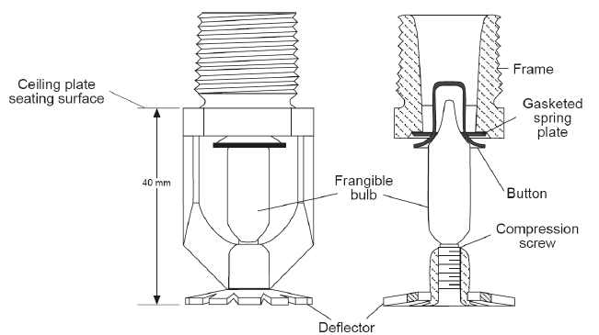
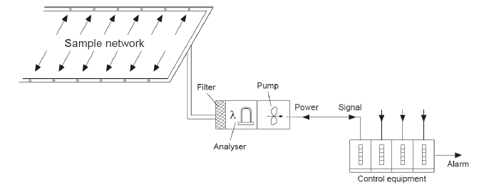
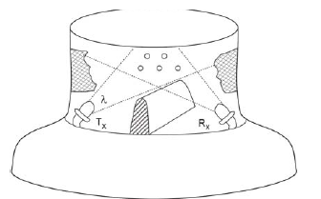
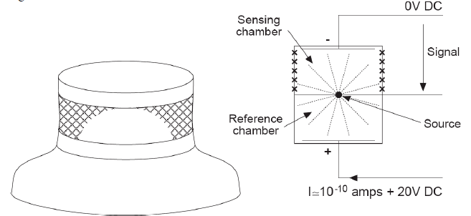
Smoke Detection Diagrams
Sprinkler Hose
Aspirating
Photoelectric
Ionisation Chamber

Slide 12
Fire suppression - will be discussed in the next phase. Various ways to suppress fires in the case of fire breakthroughs. Different types will be discussed.

Slide 13
Collecting data –
Data required for research -
Ware house details,
Ware House Dimensions,
server room dimensions,
number of servers.
Coordinates of servers in the room
All data will be collected in the next phase

Slide 14
Graph based approach –
The server room and data center will be modelled as a grid. Each square in the grid represents a server rack. Four coordinates denote the square. When fire breaks out squares will be red, when fire is extinguished fire squares will be green. Algorithm will be discussed in next phase.

Slide 15
Model simulation
The graph based approach will be simulated and various results will be obtained and visualized via graphs, tables and pictures.

Slide 16
Conclusion
Discusses fire modelling and simulation in fire centers. A background study on cloud services is discussed, followed by fire sources and causes. Fire detection is discussed in details and then on fire suppression. A graph based approach is discussed with details of collected data – dimensions, coordinates of servers etc. Modelling the data centers and servers in a grid fashion and using color code and algorithms to detect and suppress fire break outs. Model will be simulated and results obtained and discussed. Further research will be done in future.
For future work
The given graph based approach will be further refined to take more variables into account. More advanced algorithms will also be implemented in our design and will be simulated in different scenarios as well. Our method will also be tested with fire fighting droids for data centers. The method will also be tested on multi-floor data centers in the future.

Slide 17
REFERENCES
1) T. Broughton and D. Laibach, “Four important considerations for data center fire protection,” 2023. [Online]. Available: https://facilityexecutive.com/four-important-considerations-for-data-center-fire-protection/ 2) L. et al., “Exploratory analysis of fire statistical data and prospective study applied to security and protection systems,” international-journal-of-disaster-risk-reduction, vol. 61, p. 102308, 2021. 3) H. A. Rahardjo and M. Prihanton, “The most critical issues and challenges of fire safety for building sustainability in jakarta,” Journal of Building Engineering, vol. 29, p. 101133, 2020. 4) S. T. Ahmed, B. J. Khadhim, and Q. K. Kadhim, “Cloud services and cloud perspectives: A review,” IOP Conference Series: Materials Science and Engineering, vol. 1090, p. 012078, 2021. 5) A. Nasri, “Energy-efficient cloud servers: an overview of solutions and architectures,” The International Journal of Robotics Research, vol. 13, pp. 33–44, 2021. 6) M. Zhang, “Data center fires: A detailed breakdown with 22 examples,” 2023. [Online]. Available: https://dgtlinfra.com/data-center-fires/ 7) M. Spearpoint, “Fire detection,” New Zealand Science Teacher, no. 117, pp. 14–16, 2007.

Slide 18
Thank You
Any Questions?

